Slide 1

FINEder
CIS 9660 – Group 5
(Milestone #1)

Slide 2

Agenda
Introduction
Who Are We? — Background
What is FINEder?
Mission Statement / Objective
Target Market
Why It Matters
How we do it — Data Mining
Conclusion

Slide 3
Founding Team
Afaqul Haque – Chief Executive Officer (CEO)
Urvaksh Irani - Chief Operating Officer (COO)
Shannon Paes - Chief Technology Officer (CTO)
Eric Chow - Chief Financial Officer (CFO)
Paul Leefoon - Chief Marketing Officer (CMO)
Tony Tan - Chief Information Officer (CIO)

Slide 4
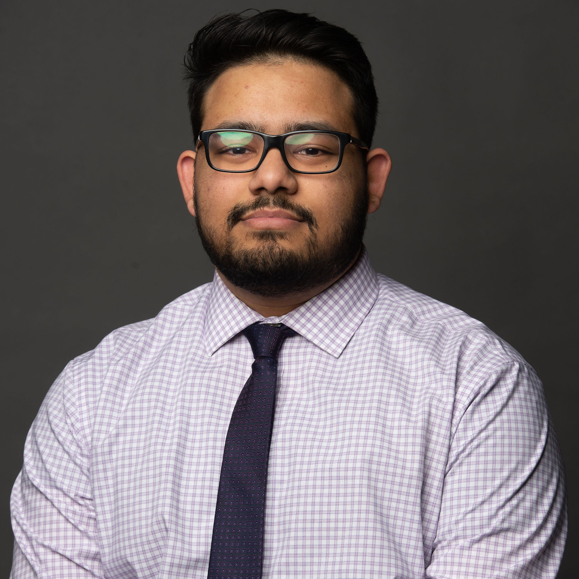
Chief Executive Officer - Afaqul Haque
Background
Several years of experience in Accounting and Marketing in various industries, such as Banking, Law, and Tech
Role on the Team
Ensuring the quality of the app and presenting it to investors and consumers
Overlooking the team and goals of the company

Slide 5

Chief Operating Officer - Urvaksh Irani
Background
Bachelors and Masters in Accounting
Masters in Business Analytics
Specialization in Data Mining & Data Visualization
Role on the Team
Overseeing Administrative and Operational functions of the Business
Ensuring the model is effective and bug free and is capable in communicating the required message to the client

Slide 6
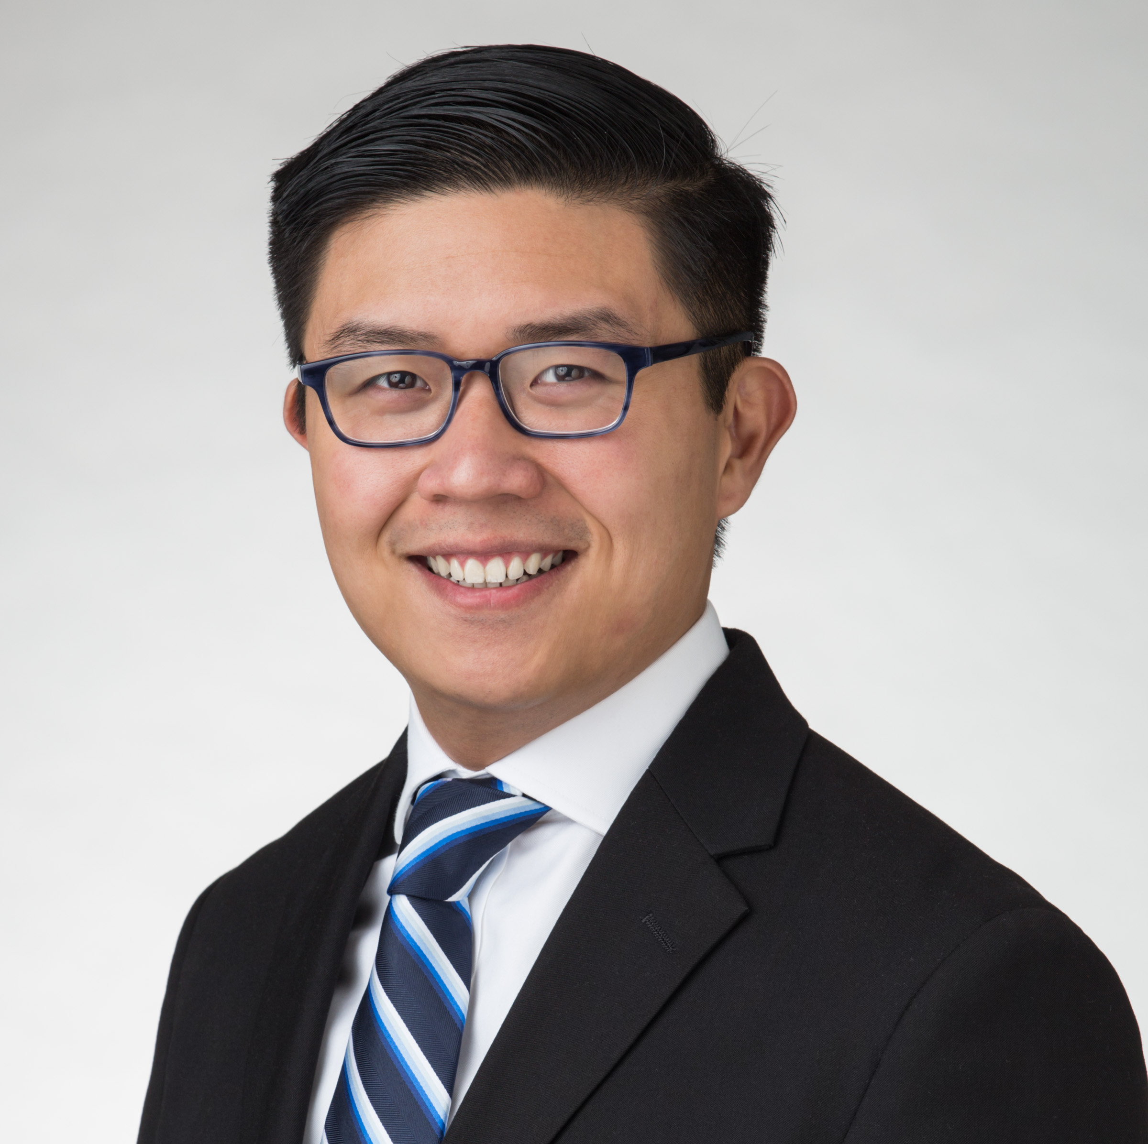
Chief Financial Officer – Eric Chow
Background
SUNY Binghamton: BS in Finance
Seven years of industry experience in finance, banking, data analytics, and automation
Chartered Financial Analyst (CFA)
Role on the Team
Secure company funding
Monetization strategies

Slide 7
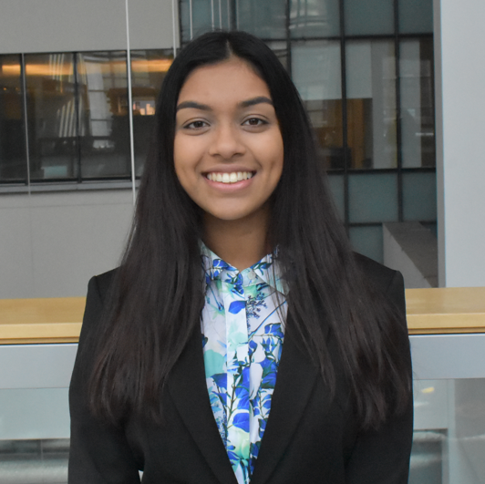
Chief Technology Officer – Shannon Paes
Background
BBA in Computer Science at Princeton University
20 years of experience at Sonin as Senior App Developer
Role on the Team
Designing and overseeing set up of the app's infrastructure
Managing the infrastructure and security of the app after launch

Slide 8

Chief Marketing Officer – Paul LeeFoon
Background
BA in Environmental Economics and a Minor in Psychology.
Role on the Team
Promoting the benefits of our app to various demographics and consumers
Establishing connections with local communities across NYC

Slide 9
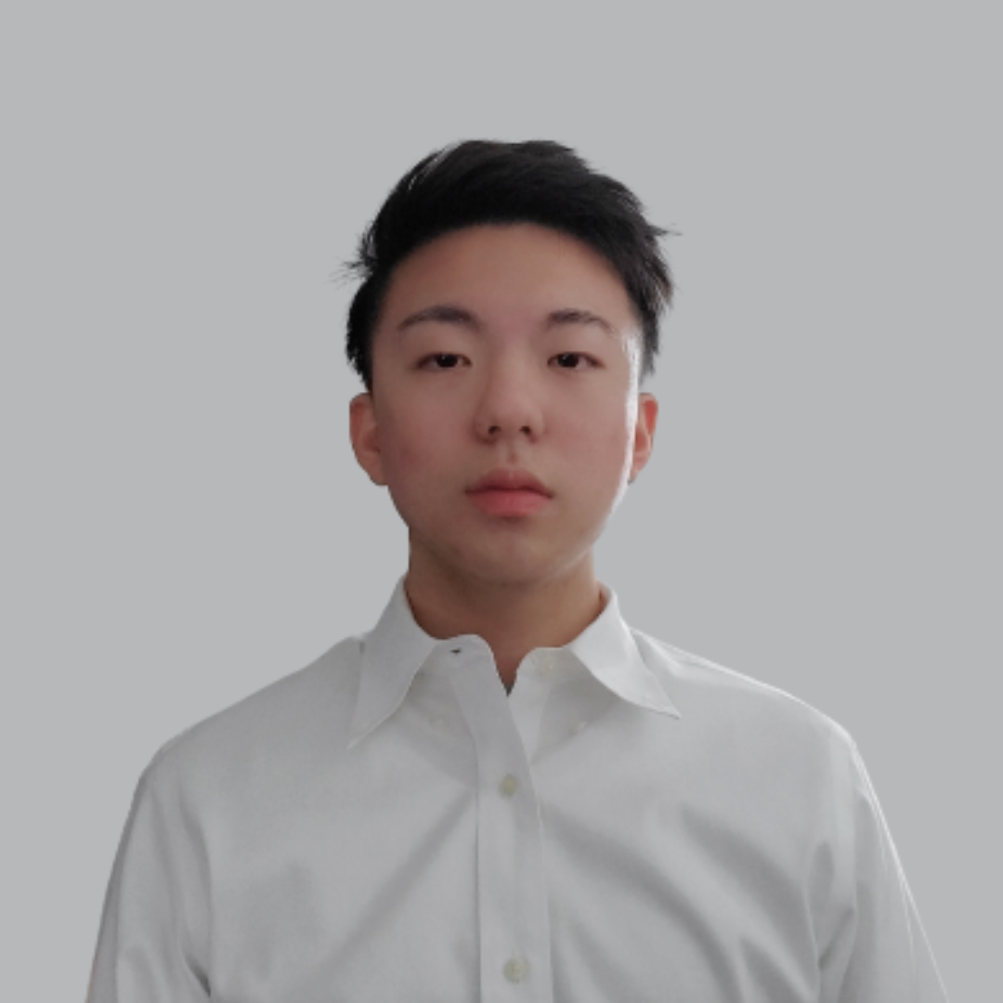
Chief Information Officer – Tony Tan
Background
Bachelors and masters in computer science
10 years of experience in management consulting
Role on the Team
Responsible for the management and implementation of the business processes
Meeting with clients and updating them on our projects

Slide 10
Welcome To FINEder ~ Find the Fine ~

Slide 11


What is FINEder?
FINEder is an app aimed at helping people and business across NYC predict and avoid the likelihood of receiving a parking violation in a specific area
Simply enter the zip code and/or address and receive statistics on violations in that area!
Users can also anonymously enter if they recently received a violation, as well as enter comments for other users to view
App will also notify users if any parking rule changes are enforced
Great for locals and tourists who plan on driving around NYC!

Slide 12
Mission Statement
Our mission is to create a hassle-free journey for travelers, residents and coworkers. Our application safeguards individuals from parking violations in the city and at the same time avoids unnecessary clutters and traffic jams.

Slide 13
Objective
Funding from angel investors for our software and mobile app business
Our model will help identify common traffic violation factors in hopes to help our clients adhere to New York's traffic and parking regulations
Investor proceeds will be used to hire software developers and marketing personnel

Slide 14



Target Market for App/Software
We are pitching this app to e-commerce delivery companies such as FedEx, UPS, etc.
Private companies that rely on employee transportation in and around the New York metropolitan area.
Our app is designed to help individuals and companies avoid unwanted parking fines in New York City.
Finally, we believe our app is uniquely capable to augment existing navigation apps to better service New York residents and out of state visitors.

Slide 15
Why It Matters
You're most likely to get a ticket in these NYC neighborhoods (Nov 2021)
"between October 2020 and September 2021, the City of New York issued a total of 4,006,011 parking tickets and made close to $260 million in revenue. Believe it or not, that number was actually twice as high pre-pandemic."
The Great Gotham Vroom Boom of 2020 (Aug 2020)
"the New York State D.M.V. processed 73,933 original car registrations in the five boroughs over June and July, a 18 percent increase over the 62,507 registrations from the same time last year."
https://www.timeout.com/newyork/news/youre-most-likely-to-get-a-ticket-in-these-nyc-neighborhoods-112321
https://www.nytimes.com/2020/08/12/style/car-buying-new-york-coronavirus.html

Slide 16
Why It Matters (Cont'd)
Back of the Envelope
80,000 Uber Drivers in NYC
X 2 tickets per year
X $100 per ticket
= $16,000,000 in fines per year
80,000 Uber Drivers in NYC
X 2 tickets per year
X 2 hour of lost time per ticket
X $40 per hour of lost time
= Additional $12,800,000 of value lost per year
UPS, FedEx Rack Up Parking Violations As City Struggles To Reduce Congestion (February 2020).
"Freight carrier UPS paid $23 million in New York City parking violations last year, while FedEx paid $9 million, according to the city's Department of Finance."
https://www.ridester.com/how-many-uber-drivers-are-there/#:~:text=New%20York%20is%20another%20prominent,in%20New%20York%20City%20alone.
https://www.investopedia.com/articles/personal-finance/021015/uber-versus-yellow-cabs-new-york-city.asp
https://gothamist.com/news/ups-fedex-rack-parking-violations-city-struggles-reduce-congestion

Slide 17
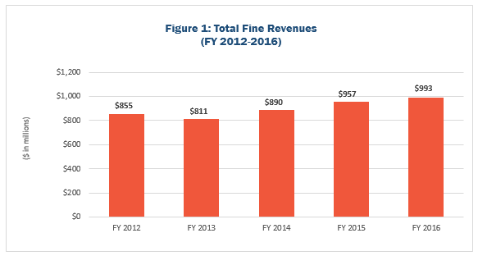
Fine Statistics
In 2016, parking fines in NYC was largest category at 545 million dollars in revenue for the city.
The city issue anywhere from 9 – 11 million tickets a year.
Parking tickets range from $35-515.

Slide 18
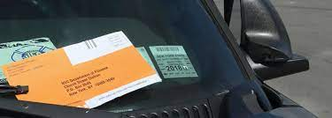
NYC Traffic Violation Data
We plan to use NYC Traffic Violation Data to predict how likely a consumer or business entity will be charged a traffic violation. We will look at both quantitative and qualitative variables.

Slide 19

Quantitative
Qualitative
Issue Date
Vehicle Expiration Date
Violation Time
Vehicle Year
Parking Start Hours
Parking End Hours
Plate ID
Summons Number
Plate Type
Violation Code
Vehicle Make
Violation County
Intersecting Street
Vehicle Color
Vehicle Body Type
Violation location

Slide 20

Thank You!
Please reach out if you have any questions:
Eric Chow - Eric.Chow@Fineder.com
Afaqul Haque - Afaqul.Haque@Fineder.com
Urvaksh Irani - Urvaksh.Irani@Fineder.com
Paul Leefoon – Paul.Leefoon@Fineder.com
Shannon Paes - Shannon.Paes@Fineder.com
Tony Tan - Tony.Tan@Fineder.com

